Slide 1
Introduction of Electrical Power Subsystem
Geuk-Nam Kim
Room 618 Science Building, 2019.07.11

Slide 2
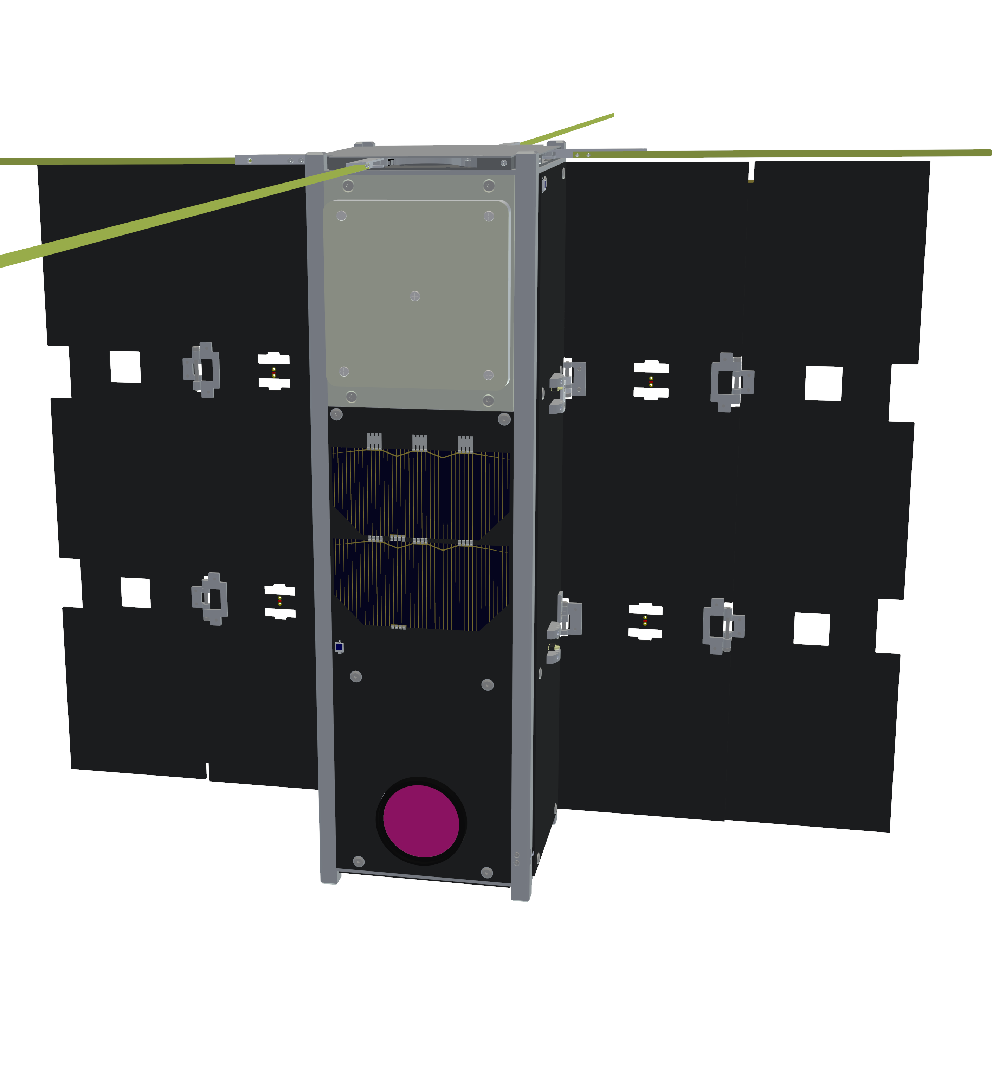
Contents
What is EPS?
EPS Configuration
Power Analysis I
Power Analysis II
Conclusion

Slide 3
What is EPS?

Slide 4
Overview
Definition
Manage power supply and distribution to subsystem components, and generate electrical power
Requirement and Constraint
Activation switch: remove before flight (RBF) / separation switch
Power interface: voltage regulation and supply / single ground / limitation in capacity / bus or switch voltage supply
Power generation & consumption (budget): solar panel / duty / margin / depth of discharge / state of charge
Mechanical design: dimension & mass / battery temperature
Telemetry & telecommand: health data collection / health data transmission / command reception
+ Etc.: detect and isolate error (watchdog timer, external EDAC) / conformal coating / outgassing …

Slide 5
EPS Configuration
Hierarchy
EPS
Solar Array
PCDU
Battery
Solar Cell
MCU
Li-polymer
Bypass
Diode
PCM
Shield
Sensors
PDM
Activation
Switch
BCR
Heater
Activation
Switch
Sensors
Deployment
Sensors

Slide 6
Power Analysis
Budget Management
Purpose: check EPS capability for the operation of H/W components, and worst case analysis for power consumption and generation
Energy Balance Analysis
Purpose: check changes of DoD (Depth of Discharge) & SoC (State of Charge) over several periods, and redesign ConOps (Concept of Operations) to satisfy EPS requirements and constraints
Mathematical system modeling
Current dynamics: PV cells / battery
Orbit / attitude dynamics
Power generation, consumption, charge method, …
Analysis setting and feasibility-check
Model validation through H/W test (or numerous case studies)

Slide 7
EPS Development Scheme
#1. Set Requirements and Constraints
#2. Conceptual Design
Survey H/W as candidates
Define electrical power I/O
Define H/W components-EPS-solar array interface
Power budget based on ConOps
#3. Software-based Analysis
Energy balance analysis with mathematical H/W models
#4. Repeat #1~#3
Until #1 satisfies mission and system requirements
#5. H/W Development: Manufacturing & Verification

Slide 8
EPS Configuration

Slide 9
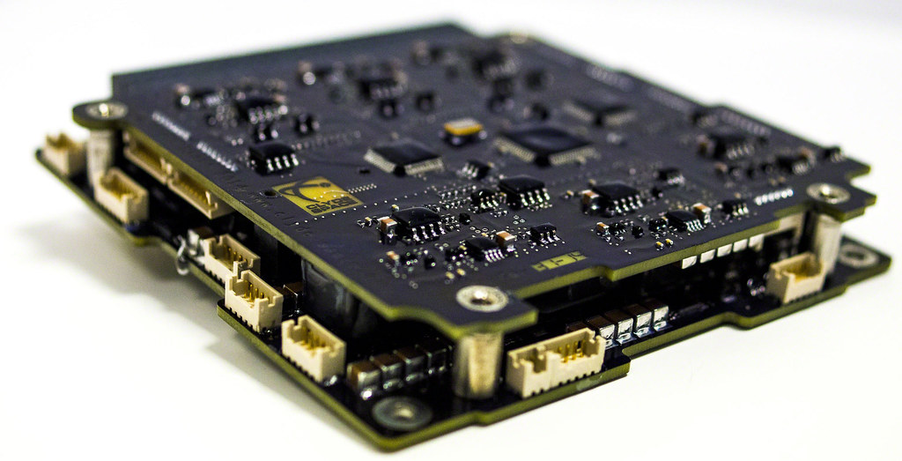
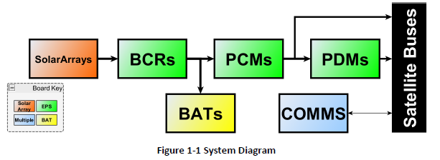
Power Distribution and Control Unit
Main Component to Manage Electrical Power I/O
BCR: Battery Charge Regulator
BUCK for high input voltage (~90%) / SEPIC for low input voltage (~80%)
Internal (or additional) MPPT: Maximum Power Point Tracker
PCM: Power Conditioning Module
PDM: Power Distribution Module
Bus Protection
Over current, battery under voltage
End of Charge (EoC)
Telemetry & Telecommand
<Clyde Space EPS diagram>

Slide 10
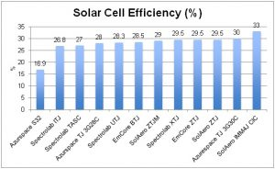
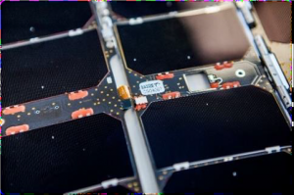
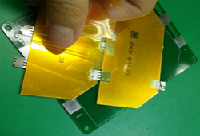
Solar Panel
Energy Generation
Solar cells: convert light energy to electrical power through the photovoltaic effect
Characteristics: low efficiency / sensitive / complicate to assemble / expensive … → But, very light material and highly reliable performance
Solar array by integrating several solar panels
Body mount panel / deployable panel
<Solar cell efficiency (1st, NASA credit), commercial CubeSat solar
panel (2nd, Clyde Space), and solar cell attachment (3rd, CANYVAL)>
Notes:
https://sst-soa.arc.nasa.gov/03-power

Slide 11
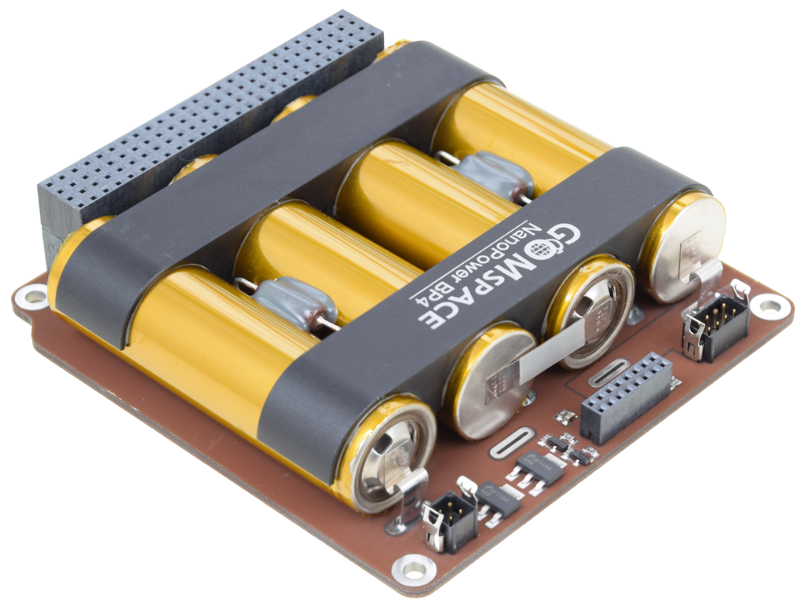
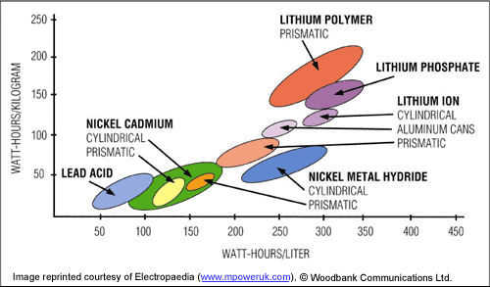
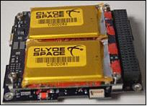
Battery
Energy Storage
Type: Li-ion / Li-polymer + Ni-Cd / Ni-MH / Pb / Ni-Zn …
High energy density to minimize system mass
Cell balancing technology on multi-string battery
Inbuilt heater system
Reliability in a vacuum environment
<Battery efficiency (left, NASA credit) and
commercial CubeSat battery (right, GOMspace and Clyde Space)>

Slide 12
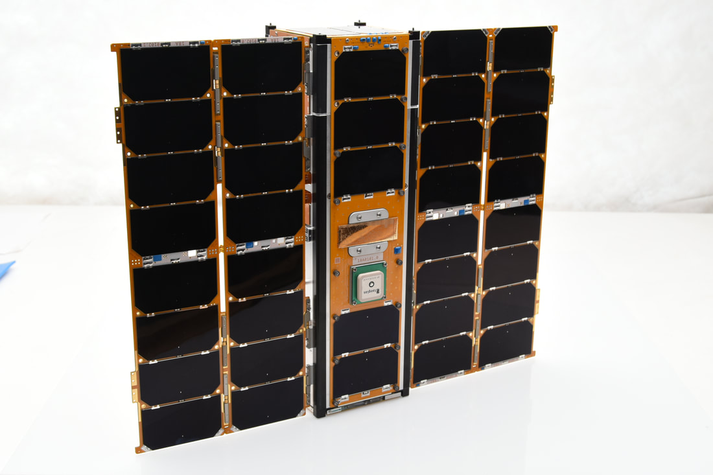
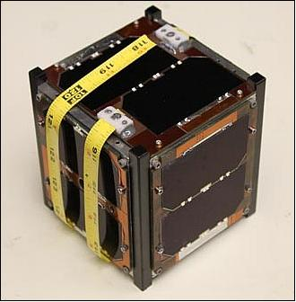
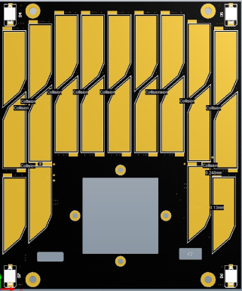
Others
Deployment
Deploy UHF antenna or solar array
Power supply, and need to manage inrush current to protect circuit
Diode and Sensor
Bypass diode to prevent a backward current
Photodiode to detect Sun-light (applicable as an attitude sensor)
Temperature sensor
<Deployable array (left, Pumpkin) and
Antenna deployment (right, M-Cubed)>
<Photodiode on solar panel (CANYVAL-C)>

Slide 13
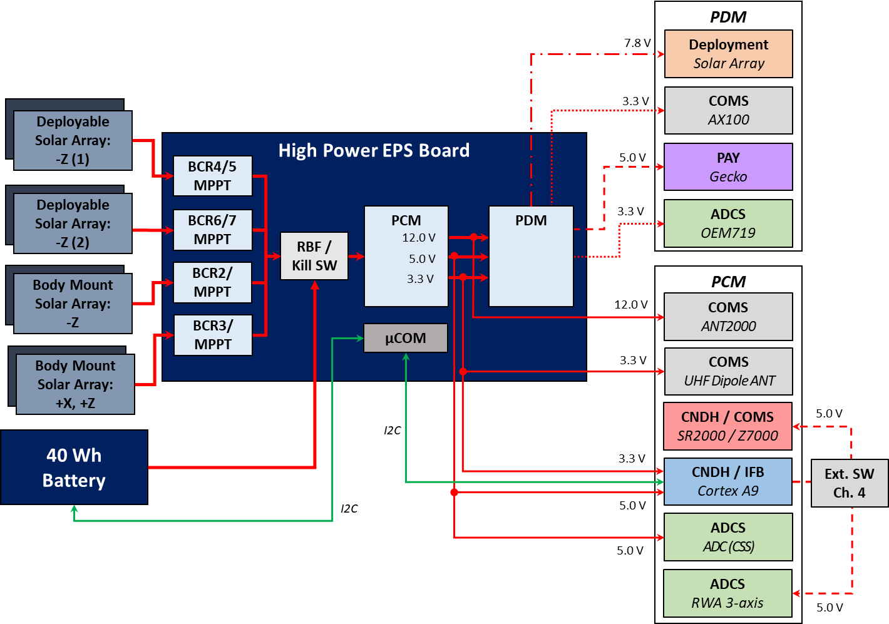
Electrical Interface
EPS to Subsystems
Max. Current / Voltage / Switch
(Channel) PCM < 4.0 A / PDM < 1.0 A
<EPS function diagram>

Slide 14
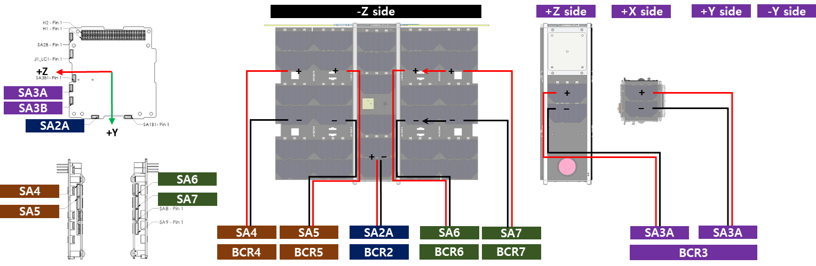
Electrical Interface
Solar Array to EPS
Input Voltage
Buck BCR (SA1, SA2): 7.4~30 V → SA2 + SA4/5, SA6/7 (High Power Bundle)
SEPIC BCR (SA3): 3.0~9.5 V
<Solar array power I/O diagram>

Slide 15
Power Analysis I: Basic

Slide 16
Overview: Power Budget
Simple Method for Electrical Power Management
Calculate the summation of duty cycled H/W power consumptions in each mode operation
Calculate loads on each bus voltage (limitation on current)
EPS design criteria: power consumption << generation
Effective way to manage power consumptions by mode, duty cycled H/W operations, the efficiency of voltage regulation, etc.

Slide 17
Power Budget [1/4]
Normal Mode: Nadir-pointing
Beacon: 1 sec transmission by 30 sec / PCM eff. 90%
Subsystem H/W | P Consumption (W) | Duty Cycle (%) | P Operation (W) | Note
Imager | 3.00 | 0 | 0.00 | Multi-spectral
OBC 1 | 2.56 | 0 | 0.00 | SDR / FPGA
OBC 2 | 0.89 | 100 | 0.89 | Main / ADCS
FSS | 0.02 | 100 | 0.02 | -
MTRQ | 1.24 | 25 | 0.31 | 2 X Rod / 1 X Air-coil
RWA | 8.33 | 25 | 2.08 | 3 axis
GPS Rx | 1.11 | 100 | 1.11 | L1
GPS Antenna | 0.11 | 100 | 0.11 | L1
EPS | 0.44 | 100 | 0.44 | PCDU / BCR
Battery | 0.89 | 0 | 0.00 | 40 Wh / Active Heater
UHF TRX | 3.33 | 3 | 0.10 | Beacon / Uplink
UHF Antenna | 0.04 | 100 | 0.04 | Deployable
S-band TRX | 2.11 | 0 | 0.00 | RX Only
S-band Antenna | 13.33 | 0 | 0.00 | Patch
Solar Array 1 | Generate | - | -8.84 | Deployable
Solar Array 2 | Generate | - | -0.50 | Body-mount
Power Margin |  |  | -4.24 | +45.3%

Slide 18
Power Budget [2/4]
Mission Mode: Nadir-pointing
Taking images / UHF communication
Subsystem H/W | P Consumption (W) | Duty Cycle (%) | P Operation (W) | Note
Imager | 3.00 | 15 | 0.45 | Multi-spectral
OBC 1 | 2.56 | 30 | 0.77 | SDR / FPGA
OBC 2 | 0.89 | 100 | 0.89 | Main / ADCS
FSS | 0.02 | 100 | 0.02 | -
MTRQ | 1.24 | 50 | 0.62 | 2 X Rod / 1 X Air-coil
RWA | 8.33 | 50 | 4.17 | 3 axis
GPS Rx | 1.11 | 100 | 1.11 | L1
GPS Antenna | 0.11 | 100 | 0.11 | L1
EPS | 0.44 | 100 | 0.44 | PCDU / BCR
Battery | 0.89 | 0 | 0.00 | 40 Wh / Active Heater
UHF TRX | 3.33 | 10 | 0.33 | Beacon / Uplink
UHF Antenna | 0.04 | 100 | 0.04 | Deployable
S-band TRX | 2.11 | 10 | 0.21 | RX Only
S-band Antenna | 13.33 | 0 | 0.00 | Patch
Solar Array 1 | Generate | - | -7.45 | Deployable
Solar Array 2 | Generate | - | -0.43 | Body-mount
Power Margin |  |  | 1.29 | -16.3%

Slide 19
Power Budget [3/4]
Communication Mode: Nadir-pointing
S-band & UHF communication
Subsystem H/W | P Consumption (W) | Duty Cycle (%) | P Operation (W) | Note
Imager | 3.00 | 0 | 0.45 | Multi-spectral
OBC 1 | 2.56 | 6 | 0.15 | SDR / FPGA
OBC 2 | 0.89 | 100 | 0.89 | Main / ADCS
FSS | 0.02 | 100 | 0.02 | -
MTRQ | 1.24 | 25 | 0.31 | 2 X Rod / 1 X Air-coil
RWA | 8.33 | 50 | 4.17 | 3 axis
GPS Rx | 1.11 | 100 | 1.11 | L1
GPS Antenna | 0.11 | 100 | 0.11 | L1
EPS | 0.44 | 100 | 0.44 | PCDU / BCR
Battery | 0.89 | 0 | 0.00 | 40 Wh / Active Heater
UHF TRX | 3.33 | 10 | 0.33 | Beacon / Uplink
UHF Antenna | 0.04 | 100 | 0.04 | Deployable
S-band TRX | 2.11 | 3 | 0.06 | RX Only
S-band Antenna | 13.33 | 3 | 0.06 | Patch
Solar Array 1 | Generate | - | -8.84 | Deployable
Solar Array 2 | Generate | - | -0.50 | Body-mount
Power Margin |  |  | -1.31 | +14.0%

Slide 20
Power Budget [4/4]
Emergency: Sun-pointing for Charging (Safe-hold)
Beacon: 1 sec transmission by 30 sec / PCM eff. 90%
Subsystem H/W | P Consumption (W) | Duty Cycle (%) | P Operation (W) | Note
Imager | 3.00 | 0 | 0.00 | Multi-spectral
OBC 1 | 2.56 | 0 | 0.00 | SDR / FPGA
OBC 2 | 0.89 | 100 | 0.89 | Main / ADCS
FSS | 0.02 | 100 | 0.02 | -
MTRQ | 1.24 | 25 | 0.31 | 2 X Rod / 1 X Air-coil
RWA | 8.33 | 25 | 2.08 | 3 axis
GPS Rx | 1.11 | 0 | 0.00 | L1
GPS Antenna | 0.11 | 0 | 0.00 | L1
EPS | 0.44 | 100 | 0.44 | PCDU / BCR
Battery | 0.89 | 0 | 0.00 | 40 Wh / Active Heater
UHF TRX | 3.33 | 3 | 0.10 | Beacon / Uplink
UHF Antenna | 0.04 | 100 | 0.04 | Deployable
S-band TRX | 2.11 | 0 | 0.00 | Only RX Active
S-band Antenna | 13.33 | 0 | 0.00 | off
Solar Array 1 | Generate | - | -17.70 | Deployable
Solar Array 2 | Generate | - | -1.01 | Body-mount
Power Margin |  |  | -14.82 | +79.2%

Slide 21

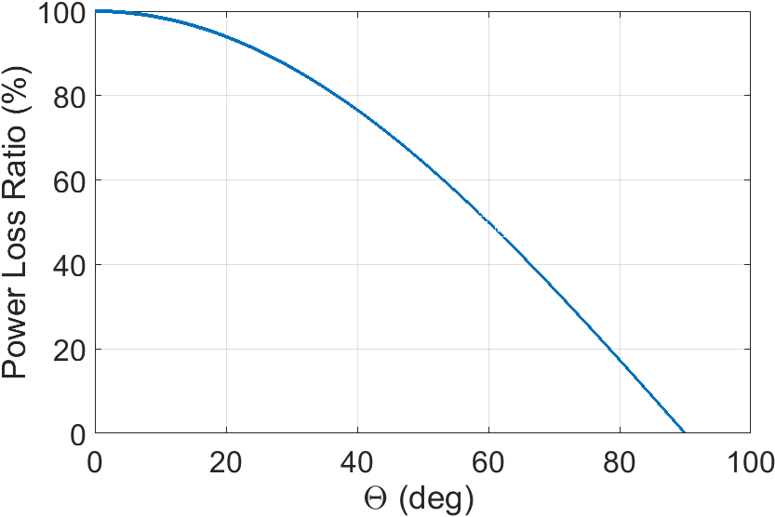
Power Generation (Simple)
#1. Rule of Thumb
P_{max} = V_{mp} X I_{mp} X # of cells (or V_{oc} X V_{sc} X solar cell efficiency)
P_{average} [W] = P_{max} X 0.6
#2. Simple Mathematical Equation (Model) with Orbit and Attitude Dynamics
P_{average} [W] = solar irradiation [W/m²] X solar cell efficiency X total solar cell area [m²] X (1-cos(incidence angle, θ))
Solar irradiation: (nominal) 1367 W/m² (1326~1408 W/m²)
θ

Slide 22
Power Analysis II: Advanced

Slide 23
Overview: Energy Balance Analysis
Current Dynamics Modeling
Li-polymer battery modeling (Clyde Space 3G EPS and battery)
PV cell array modeling (Triple Junction AZUR solar cell)
Energy Balancing Simulation
Battery SoC changes by power generation and consumption
To analyze battery DoD over mission life
Should have positive power budget in Normal mode
To analyze the entrance criteria of safe mode
Considered MPPT efficiency changes by body spin (D. M. Erb et al., 2011)
MPPT in BCR with constant current charging method (fractional open circuit voltage/current)
Considered PCM output efficiency by current

Slide 24
Overview: Energy Balance Analysis
Simulation Architecture
Spacecraft
Orbit / Attitude
Dynamics
H/W Operations
Incidence Angle
Beta Angle
Eclipse
H/W Duty-cycled Operations
Power Consumption
PV Cell Model
Battery Model
Power Generation
State of Charge

Slide 25
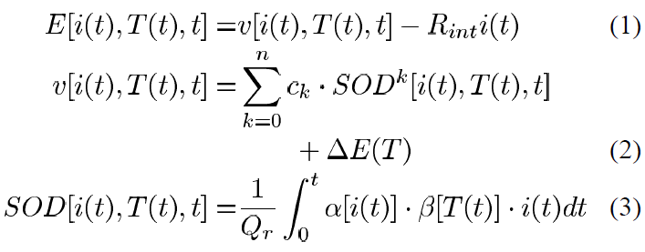
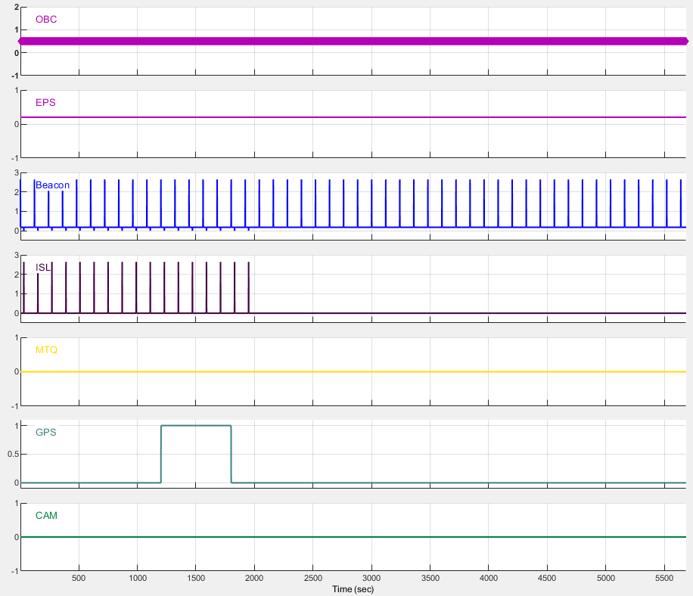
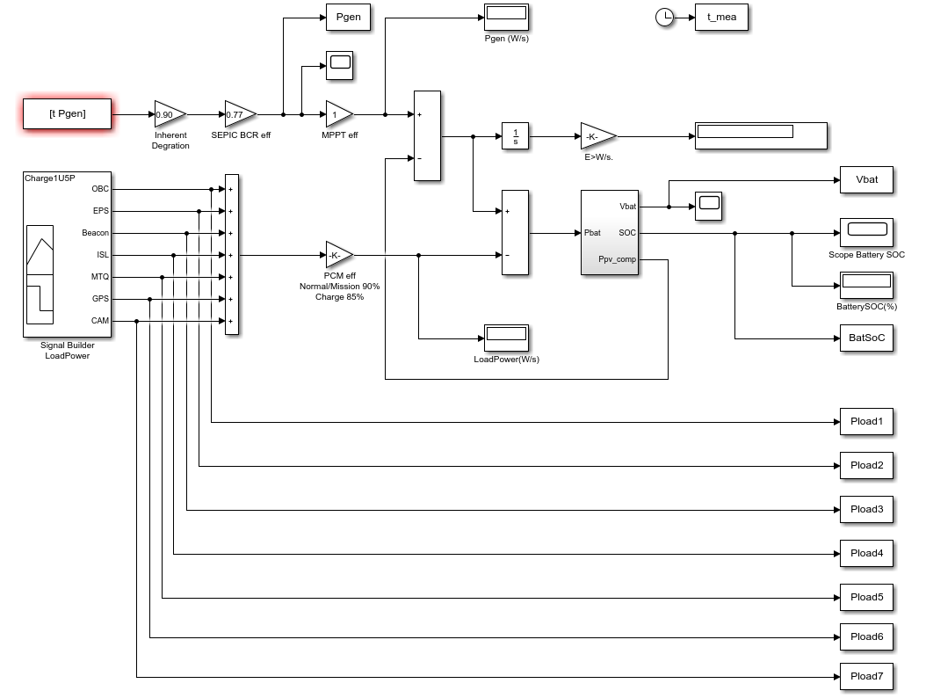
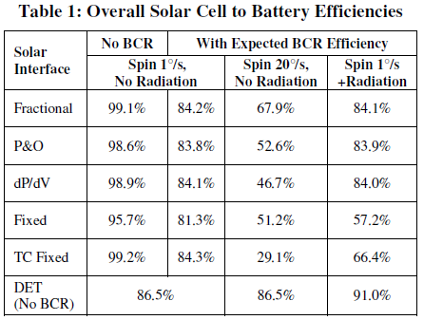
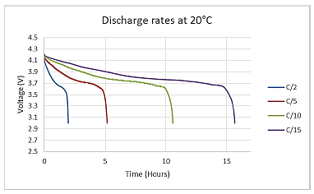
Li-polymer Battery Model [1/2]
Clyde Space Battery Model (Gao et al., 2002)
Current dynamics of Li-polymer battery
String of battery cells
Power consumption considering duty cycle
Power generation considering PV model
[Power consumption example]
* Draft by KSML

Slide 26
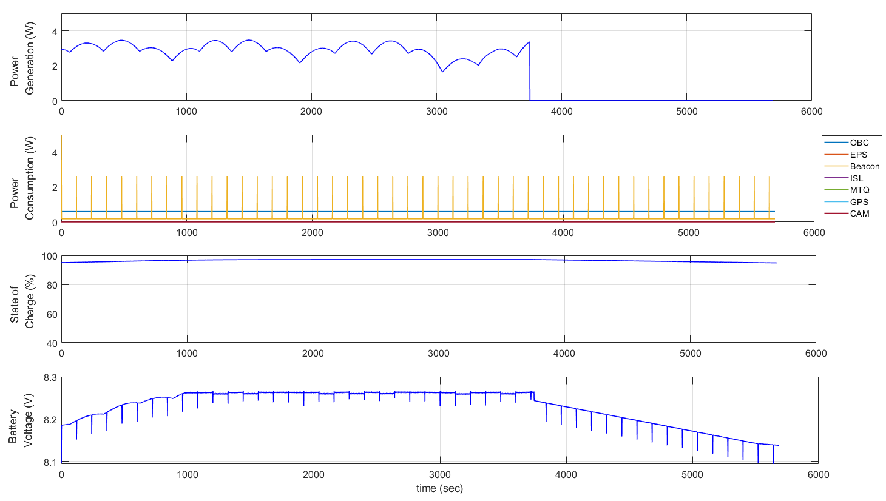
Li-polymer Battery Model [2/2]
Model Feasibility
Checked voltage draw by H/W operation
Checked end-of-charge mode
[End-of-charge mode example]

Slide 27



Photovoltaic Arrays IV-curve [1/2]
PV Array Modeling
Current dynamics (Villalva, Gazoli, and Filho, 2009)
* , : thermal voltage
MATLAB function
Input: (1) voltage, (2) irradiation (*tilted), (3) temperature
Output: (1) current
Parameter
Rs = 7.95E-02 (Ohm, Equivalent Series Resistance)
Rp = 2.62E+03 (Ohm, Equivalent Parallel Resistance)
Alpha = 3.72 (Diode Ideality Constant)

Slide 28
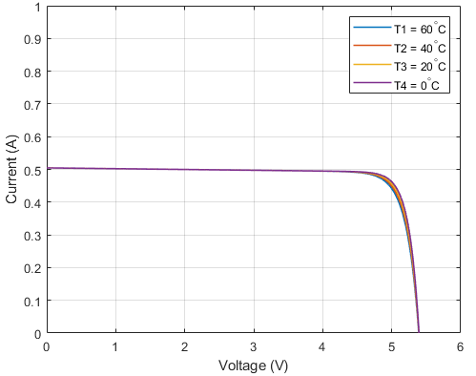
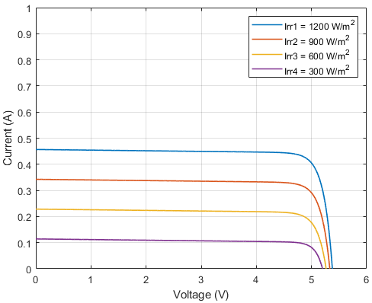
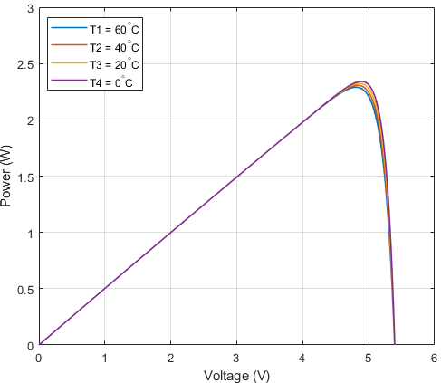
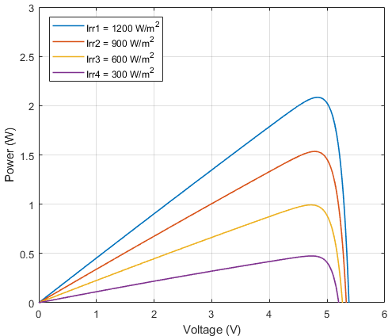
Photovoltaic Arrays IV-curve [2/2]
Perturbations on PV Cell
(1) Temperature / (2) Irradiation (@TC = 28℃) effect on PV Cell
(1)
(2)

Slide 29
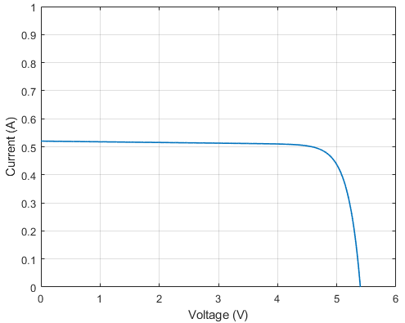
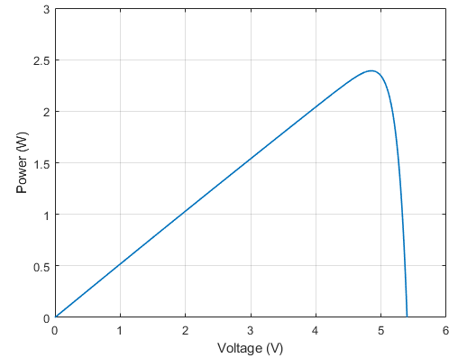

AZUR Cell IV-curve [1/2]
2 Series PV Cells
Maximum power point: 2.3902 W ($≈$ 2.4216 W) → 98% of datasheet

Slide 30
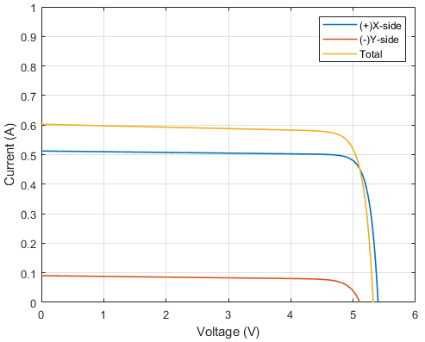
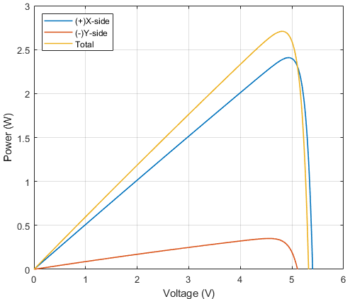
AZUR Cell IV-curve [2/2]
2 Series & 2 Parallel PV Cells
Maximum power point: ~2707.86 mW < “max. P1 + max. P2” (~97%)
Assumed a tilted orientation by 10 deg with respect to Sun vector
max. P1
max. P2

Slide 31
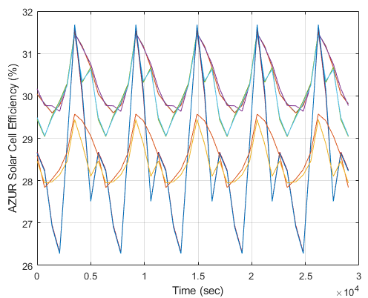
Power Generation
Orbit and Attitude Dynamics
Duration of day-side and eclipse + Beta angle (orbital parameters)
Panel’s incidence angle w.r.t. Sun (attitude pointing accuracy)
Thermal, Radiative Effect + Man-made Degradation
[AZUR cell efficiency change by temperature of each cell ]

Slide 32
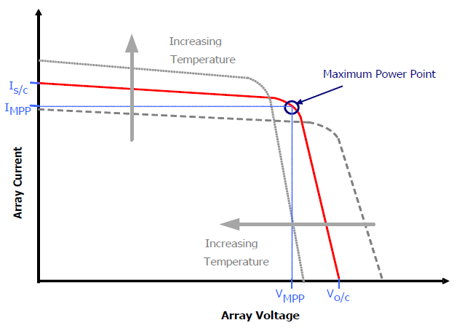
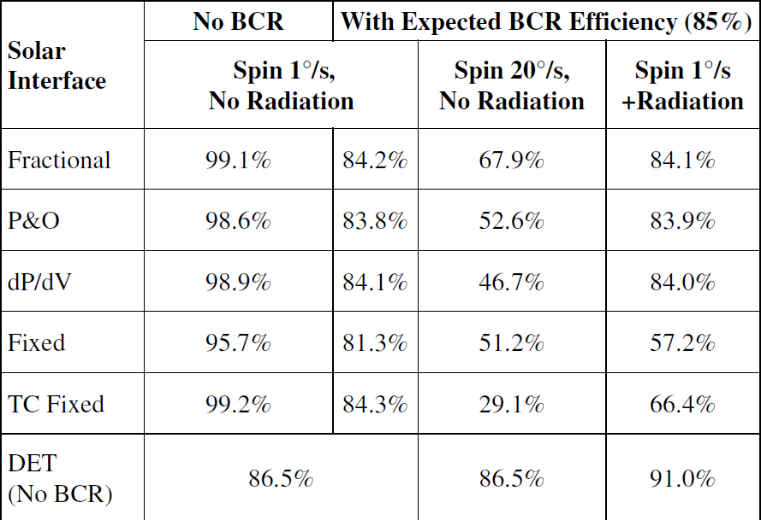
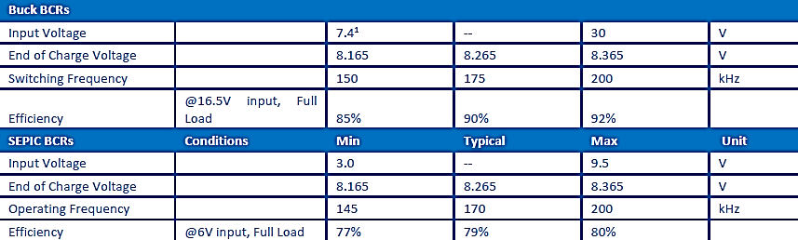
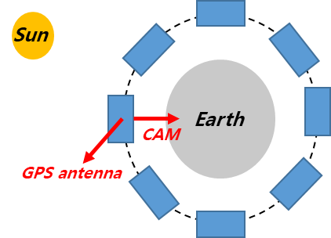
Power Generation
Efficiency of Charge Method
Maximum Power Point Tracker
Battery Charge Regulator
Albedo (10~20% of I⊙) as Margin
Inbuild MPPT on BCR
→ only affected by tumbling
Fractional Open Circuit Voltage
Need normal attitude operation strategy to maximize power generation
* Erb, Eaniel Martin, “Evaluating The Effectiveness of Peak Power Tracking Technologies for Solar Arrays on Small Spacecraft” (2011) University of Master’s Thesis.

Slide 33
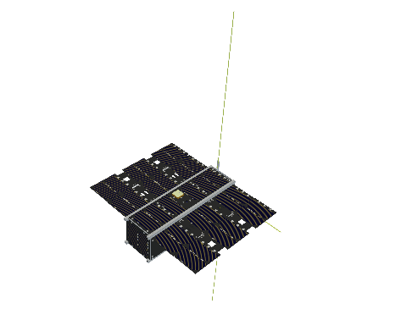
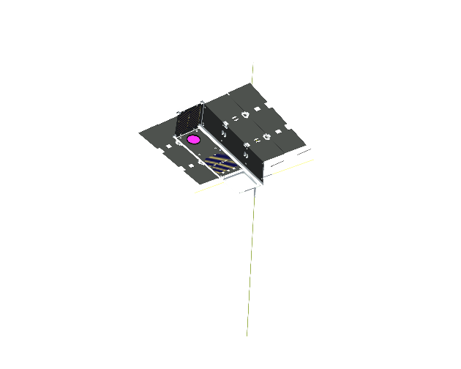





Power Generation
Sun-pointing (Day-side)
Safe-hold mode (for charging battery)
Nadir-pointing (Eclipse)
Normal / Communication / Mission mode + *protect imager
<Pointing maneuver operations>
left: Sun-pointing, right: Nadir-pointing
Notes:
nSight-1 (SCS) / Kepler (CS)

Slide 34
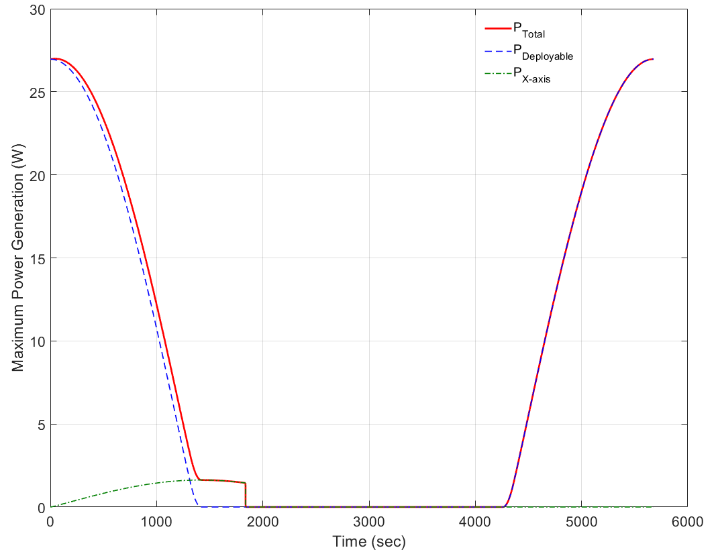
Power Generation
Nadir-pointing
Local Time on Ascending Node (LTAN), 13:30:00.000
Sun-synchronous orbit, 500 km, Inclination 97.4 deg
Beta angle, 32.94 deg
* Maximum power point tracking / BUCK or SEPIC BCR efficiency

Slide 35
Power Analysis III: Case Study

Slide 36
Concept of Operations
H/W Operations: LEOP
Subsystem | Mode | Initialization | Deployment | Detumbling
 | Power (W) | Operation: on/off (duty)
Imager | 2.70 | Off | Off | Off
OBC1 | 0.60 | On | On | On
OBC2 | 2.30 | On | On | On
FSS | 0.02 | On | On | On
MTQR | 1.19 | Off | Off | 50% Usage
RWA | Speed: 0.90 / Torque: 7.50 | Off | Off | Off
GPS RX + ANT | 1.05 | Off | Off | Off
EPS | 0.40 | On | On | On
Battery (Heater) | 0.10 (Heater: 0.80) | On (Off) | On (Off) | On (Off)
S-band TRX (ANT) | TX: 1.83 / RX: 1.58 (TX: 10.70) | RX | RX | RX
UHF TRX (ANT) | 2.81 (TRX: 0.04) | TX: 1 sec / 30 sec | On (Knife: 2 W) | TX: 1 sec / 30 sec
Power Consumption (W) |  | 2.00 | 2.37 | 2.67
Peak Power (W) |  | 5.09 | 7.31 | 6.41
Generated Power (W) |  | TBA | TBA | TBA

Slide 37
Concept of Operations
H/W Operations: Normal / Mission
Subsystem | Mode | Normal | SA Deployment | Mission
 | Power (W) | Operation: on/off (duty)
Imager | 2.70 | Off | Off | On (480 sec)
OBC1 | 0.60 | On | On | On
OBC2 | 2.30 | On | On | On
FSS | 0.02 | On | On | On
MTQR | 1.19 | 25% Usage | 25% Usage | 50% Usage
RWA | Speed: 0.90 / Torque: 7.50 | On / 25% Usage | On / 25% Usage | On / 50% Usage
GPS RX + ANT | 1.05 | Off | Off | Off
EPS | 0.40 | On | On (Knife: 2 W) | On (Knife: 2 W)
Battery (Heater) | 0.10 (Heater: 0.80) | On (Off) | On (Off) | On (Off)
S-band TRX (ANT) | TX: 1.83 / RX: 1.58 (TX: 10.70) | RX | RX | RX
UHF TRX (ANT) | 2.81 (TRX: 0.04) | TX: 1 sec / 30 sec | TX: 1 sec / 30 sec | TX: 240 sec
Power Consumption (W) |  | 6.58 | 6.95 | 10.49
Peak Power (W) |  | 7.57 | 18.91 | 25.78
Generated Power (W) |  | 8.91 | 8.91 | 8.91

Slide 38
Concept of Operations
H/W Operations: Communication / Safe
Subsystem | Mode | Communication | Charge | Detumbling
 | Power (W) | Operation: on/off (duty)
Imager | 2.70 | Off | Off | Off
OBC1 | 0.60 | On | On | On
OBC2 | 2.30 | On | On | On
FSS | 0.02 | On | On | On
MTQR | 1.19 | Off | 25% Usage | 50% Usage
RWA | Speed: 0.90 / Torque: 7.50 | Off | Off | Off
GPS RX + ANT | 1.05 | Off | Off | Off
EPS | 0.40 | On | On | On
Battery (Heater) | 0.10 (Heater: 0.80) | On (Off) | On (Off) | On (Off)
S-band TRX (ANT) | TX: 1.83 / RX: 1.58 (TX: 10.70) | TX: 120 sec | RX | RX
UHF TRX (ANT) | 2.81 (TRX: 0.04) | TX: 240 sec | TX: 1 sec / 30 sec | TX: 1 sec / 30 sec
Power Consumption (W) |  | 7.14 | 2.33 | 2.67
Peak Power (W) |  | 35.81 | 6.41 | 6.41
Generated Power (W) |  | 8.91 | 18.00 | 18.00

Slide 39
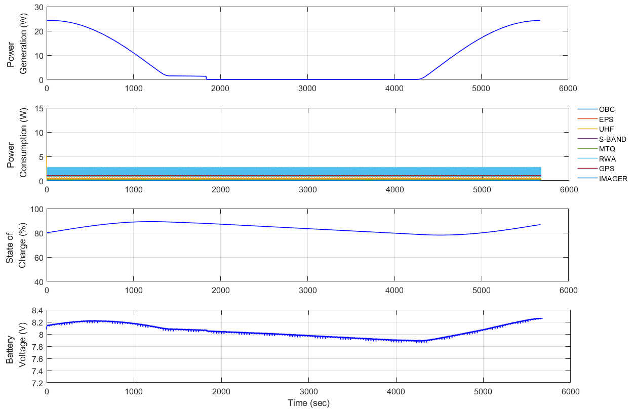
Energy Balance [1/5]
State of Charge Analysis
Nadir-pointing in Normal mode (MPPT eff. ~95%): DOD ~ 11.1%
end 86.8%
min 78.1%
End of Charge, 8.26V

Slide 40
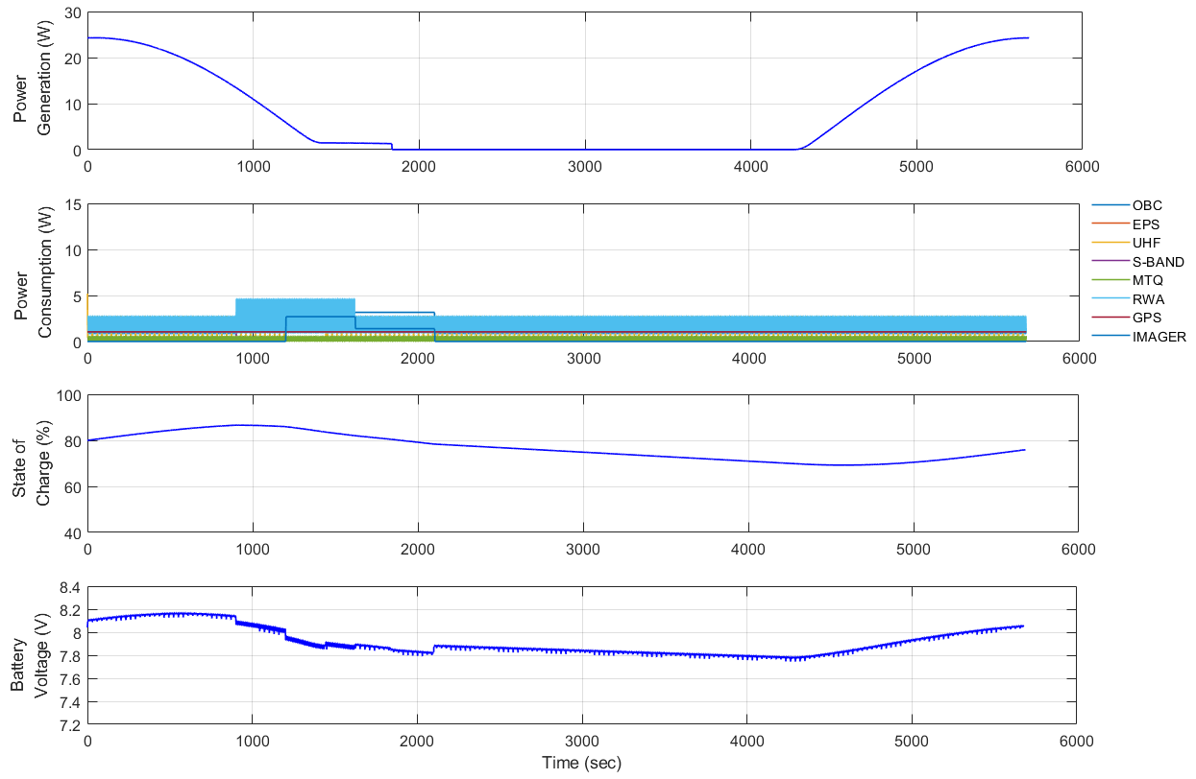
Energy Balance [2/5]
State of Charge Analysis
Attitude control in Mission mode (MPPT eff. ~80%): DOD ~ 17.4%
Payload Operation
UHF Communication
end 76.9%
min 69.2%

Slide 41
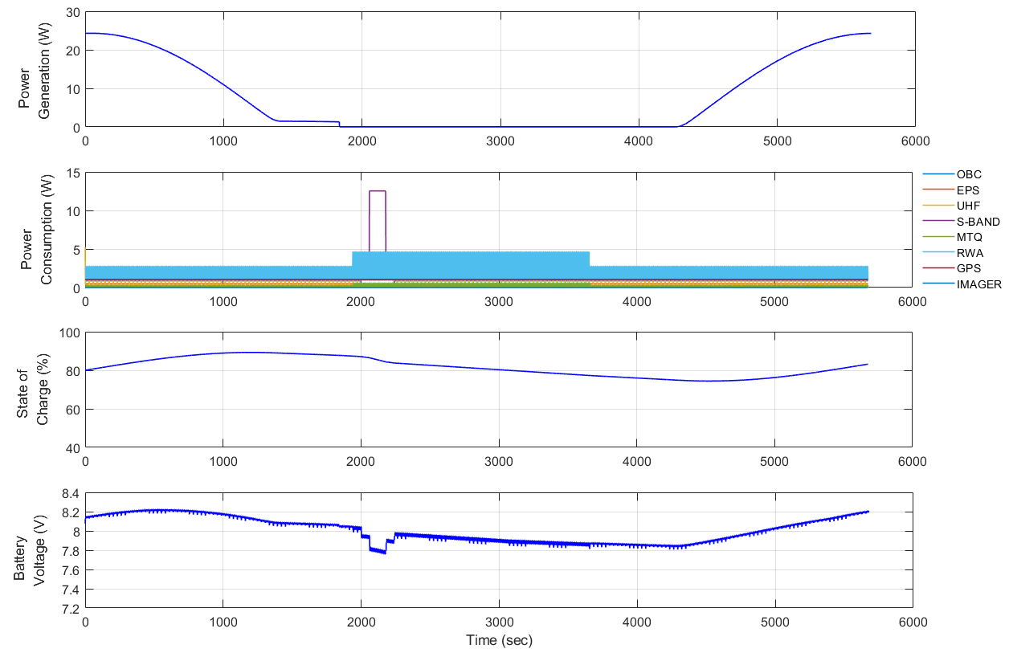
Energy Balance [3/5]
State of Charge Analysis
Communication mode in Eclipse (MPPT eff. ~95%): DOD ~ 14.8%
S-band Communication
end 83.1%
min 74.4%

Slide 42
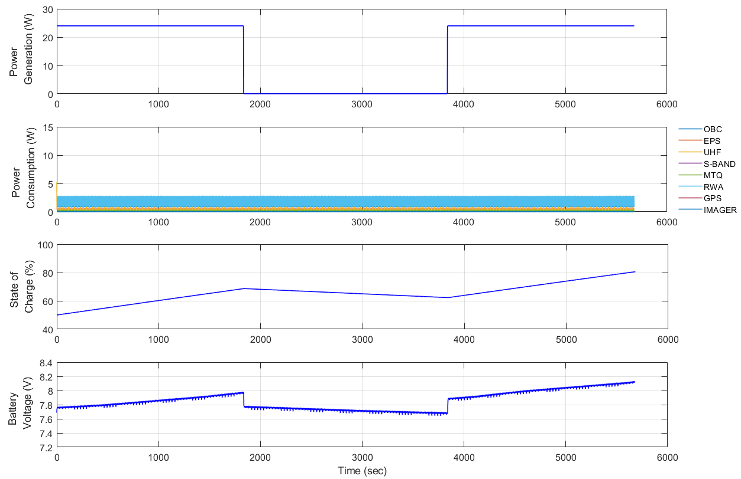
Energy Balance [4/5]
State of Charge Analysis
Sun-pointing in Safe-Hold (MPPT eff. ~95%): DOD ~ 14.8%
MTQ / RWA for Sun-pointing
end 80.6%
min 50.0%

Slide 43
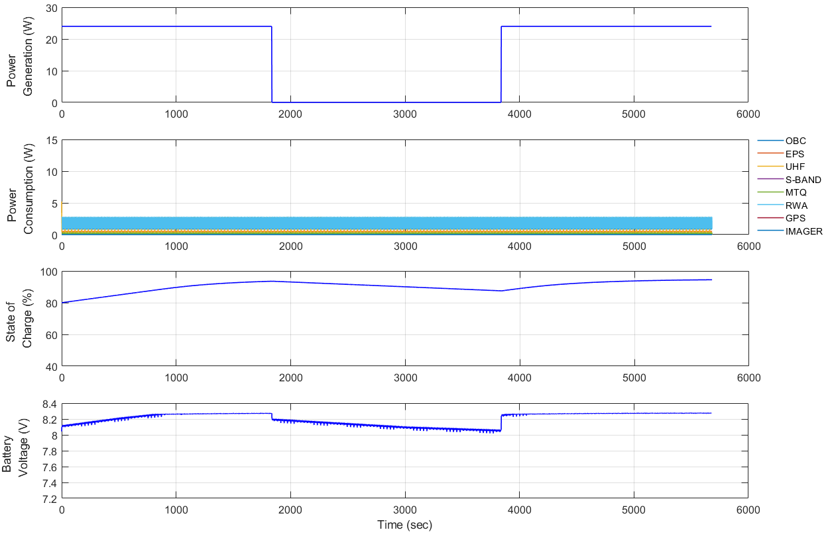
Energy Balance [5/5]
State of Charge Analysis
End-of-Charge (EoC) at 8.26 V
End of Charge, 8.26V

Slide 44
Conclusion

Slide 45
Summary
EPS Configuration
Role in spacecraft, components, architecture, interface
EPS Analysis
Power budget management
EPS mathematical model design
Energy balance analysis: integrated electrical power simulation
Key Words
PCDU – PCM / PDM
BCR – BUCK / SEPIC
MPPT
Energy Balance – DoD / SoC

Slide 46
Thank You for Your Attention
Question & Answer

